Slide 1
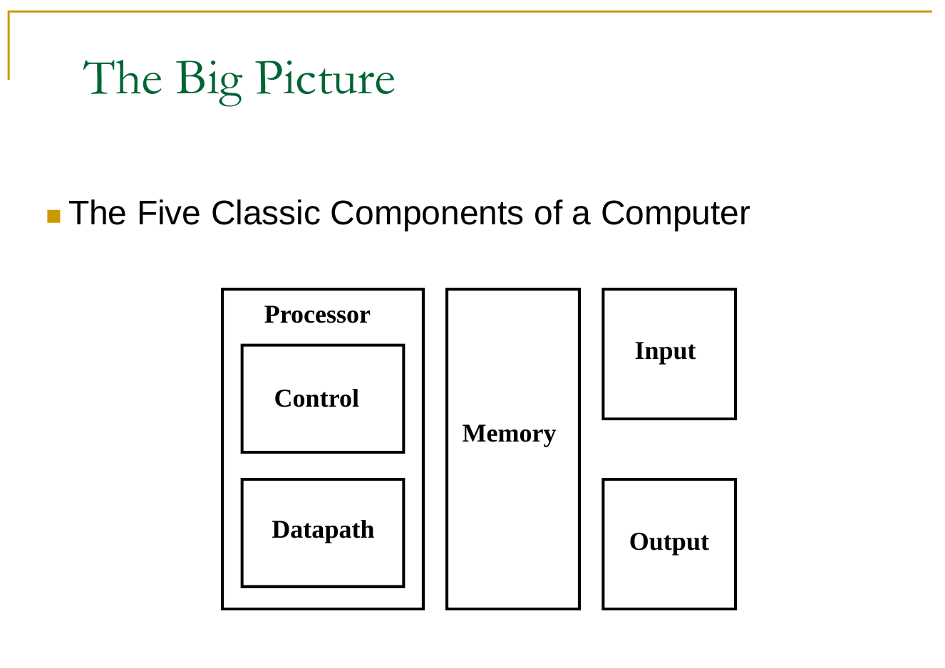

Slide 2
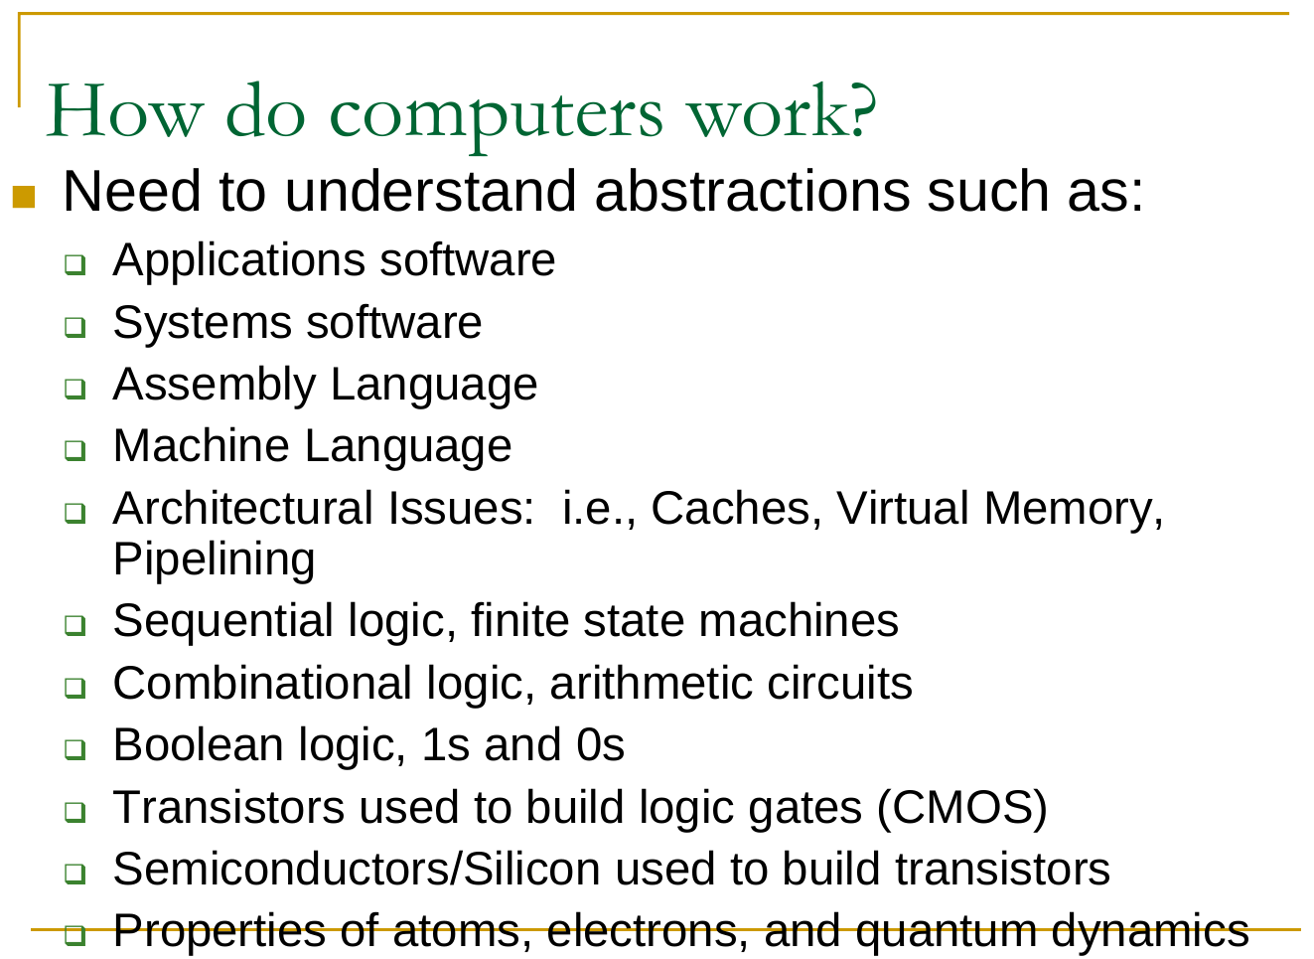

Slide 3
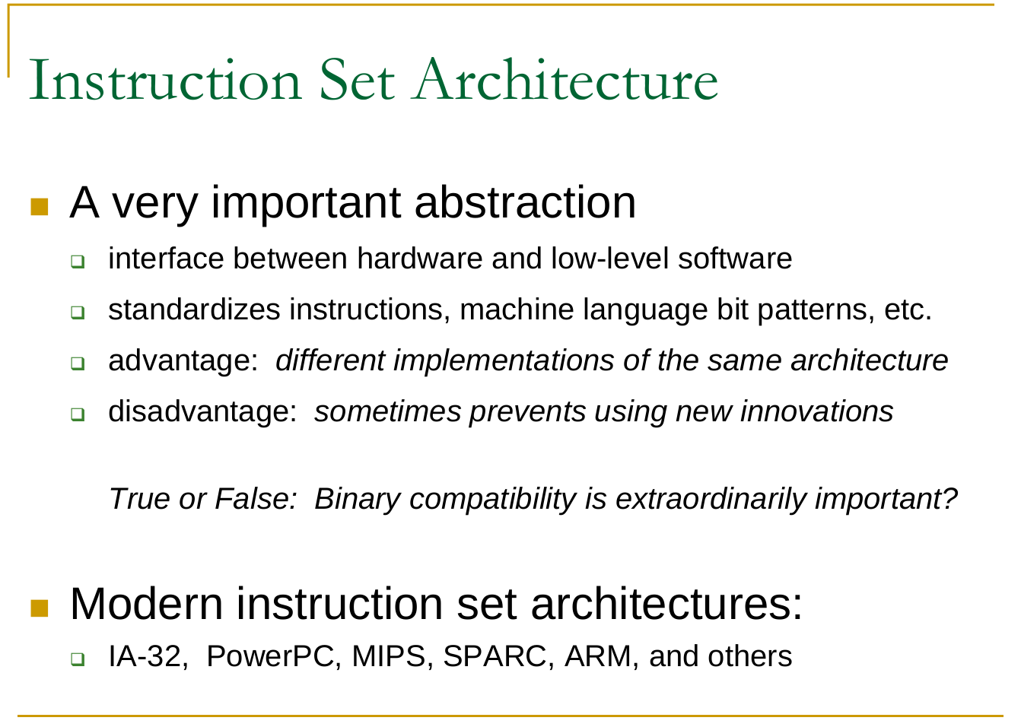

Slide 4
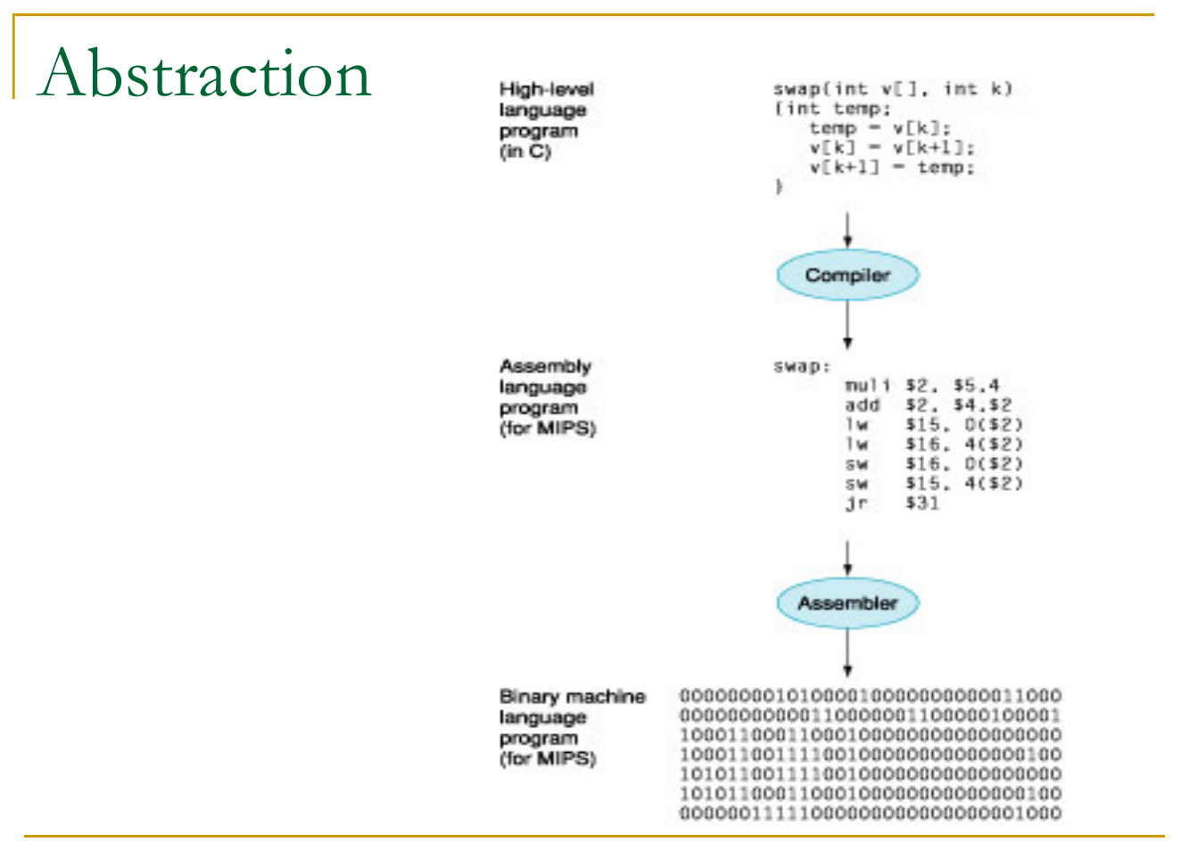

Slide 5
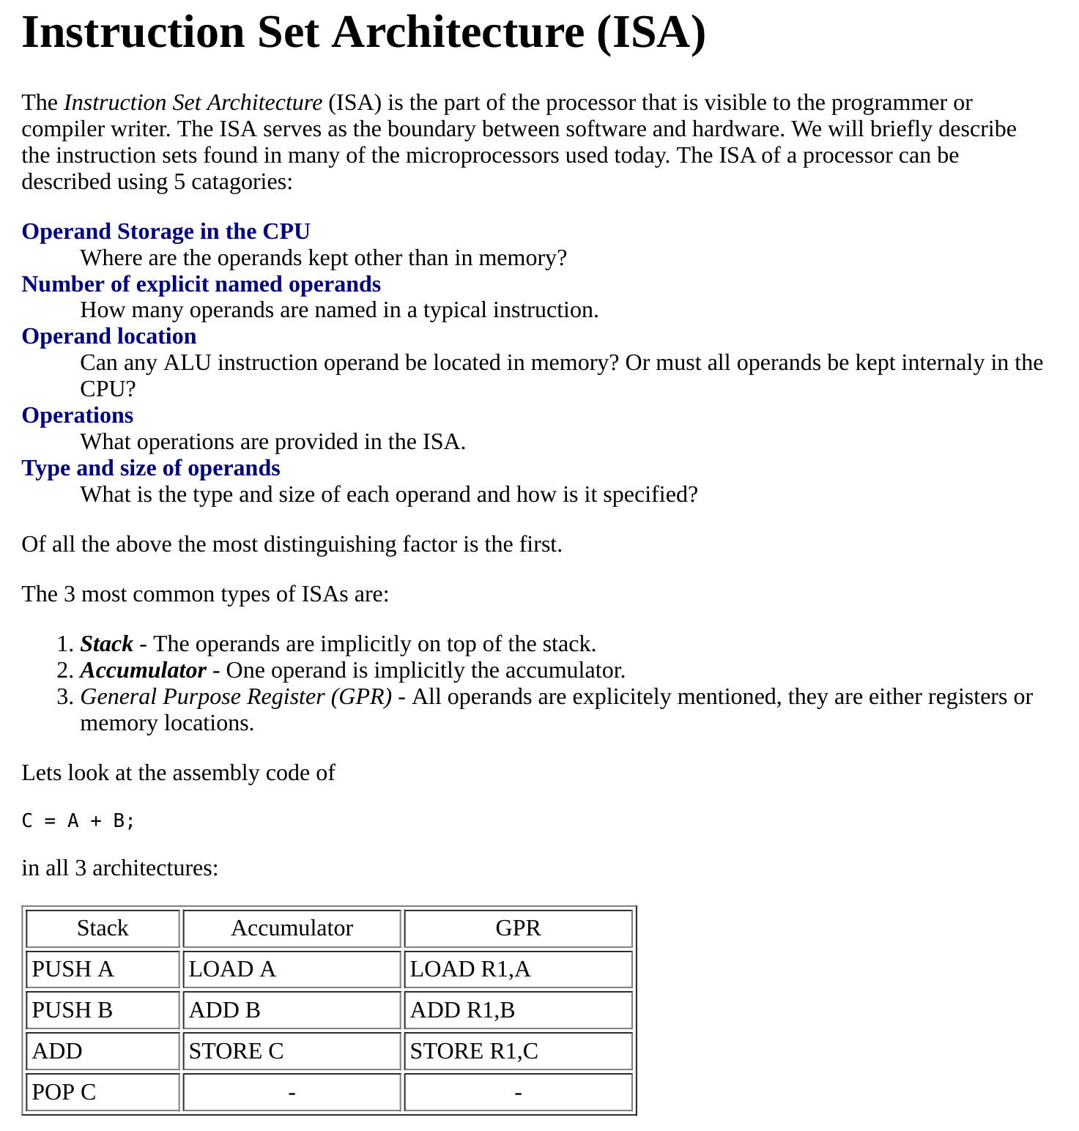

Slide 6
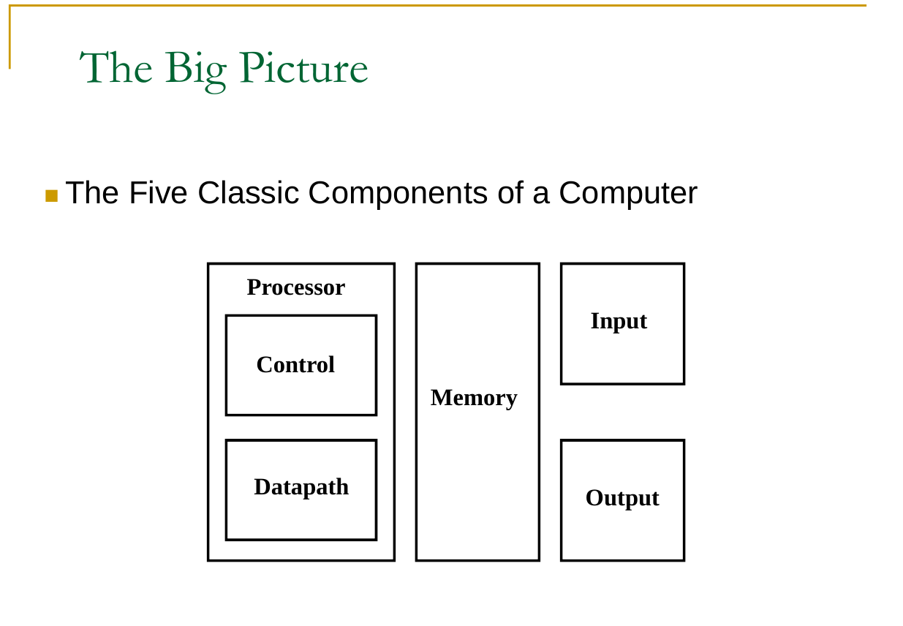

Slide 7
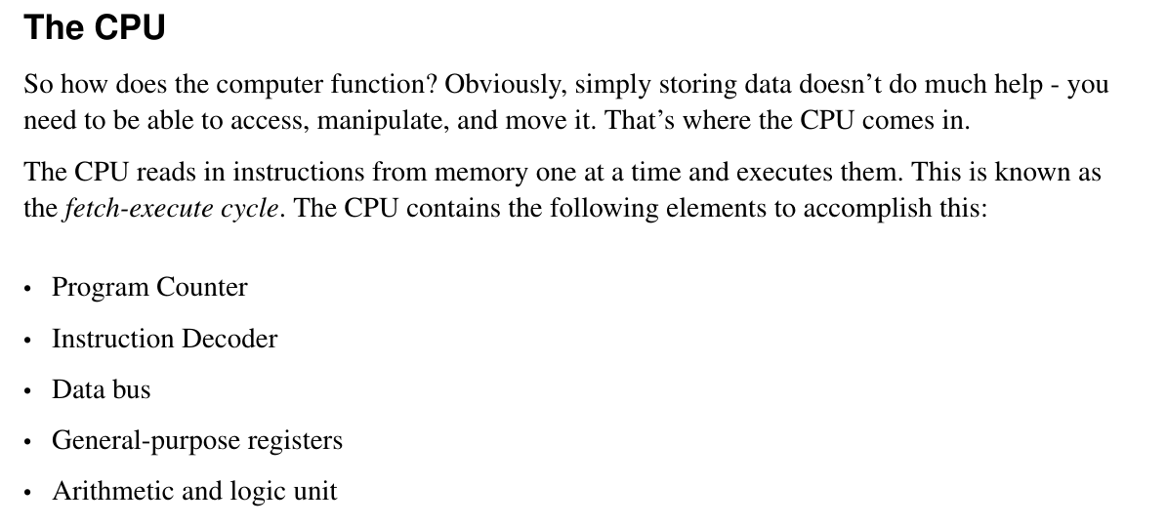

Slide 8
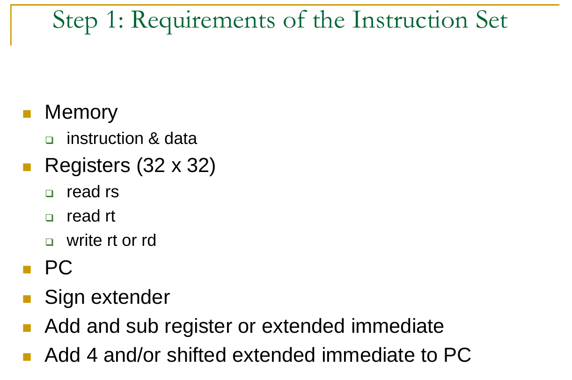

Slide 9
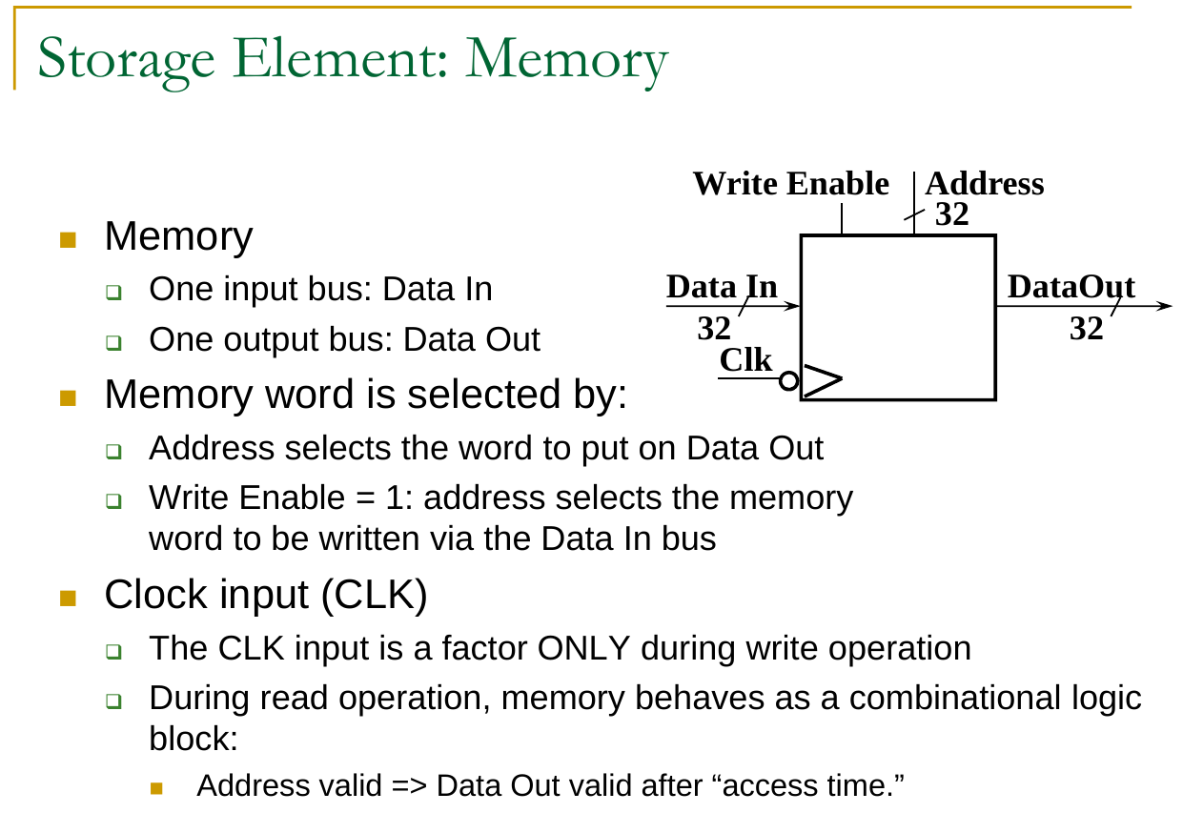

Slide 10
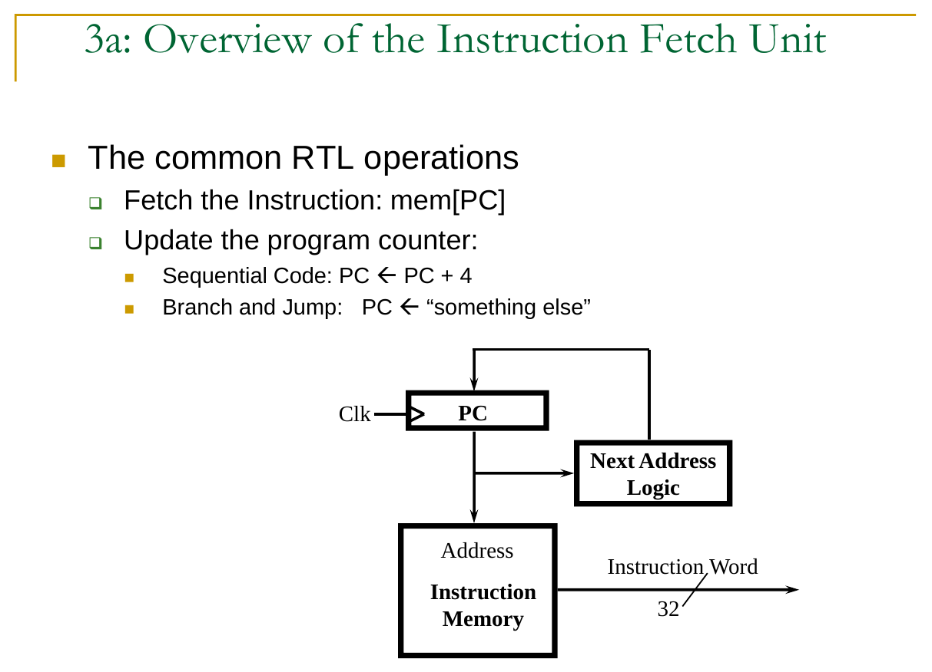

Slide 11
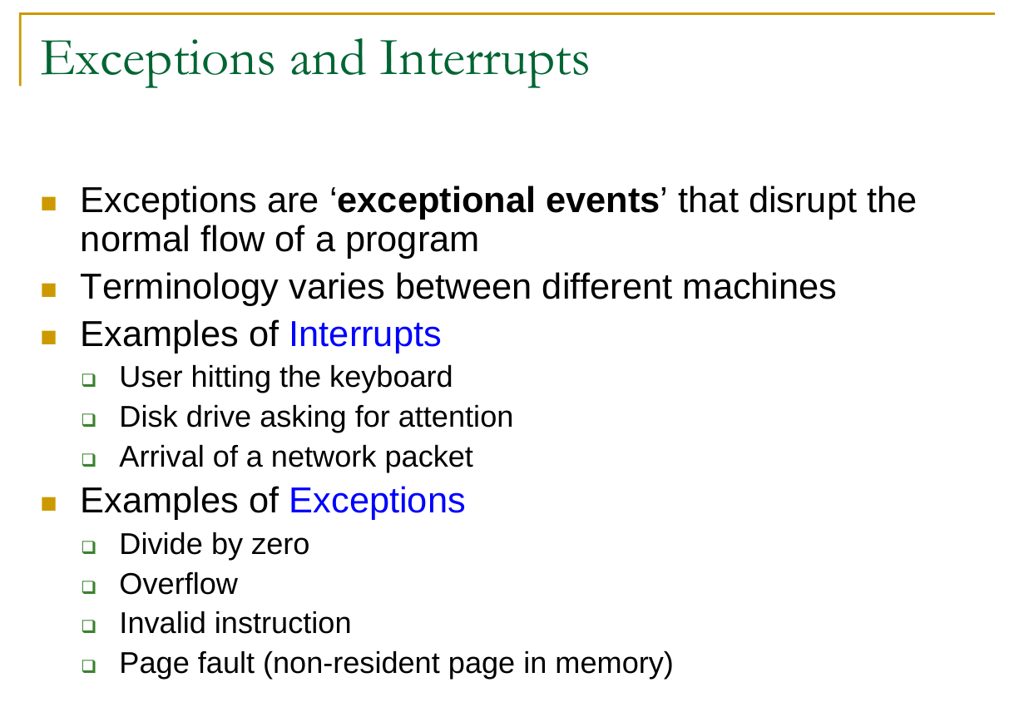

Slide 12
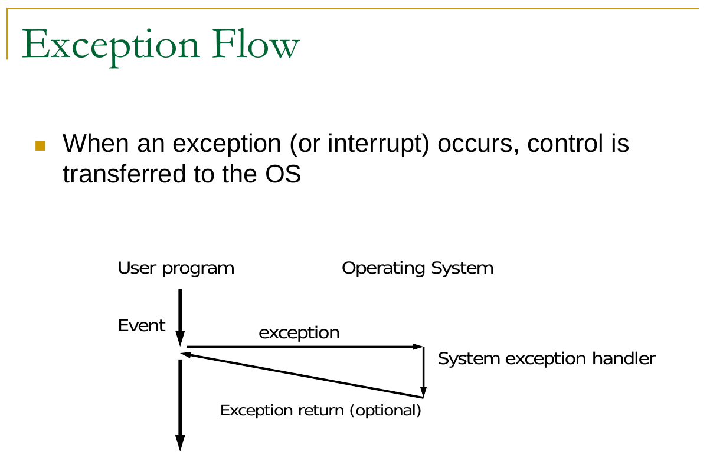

Slide 13
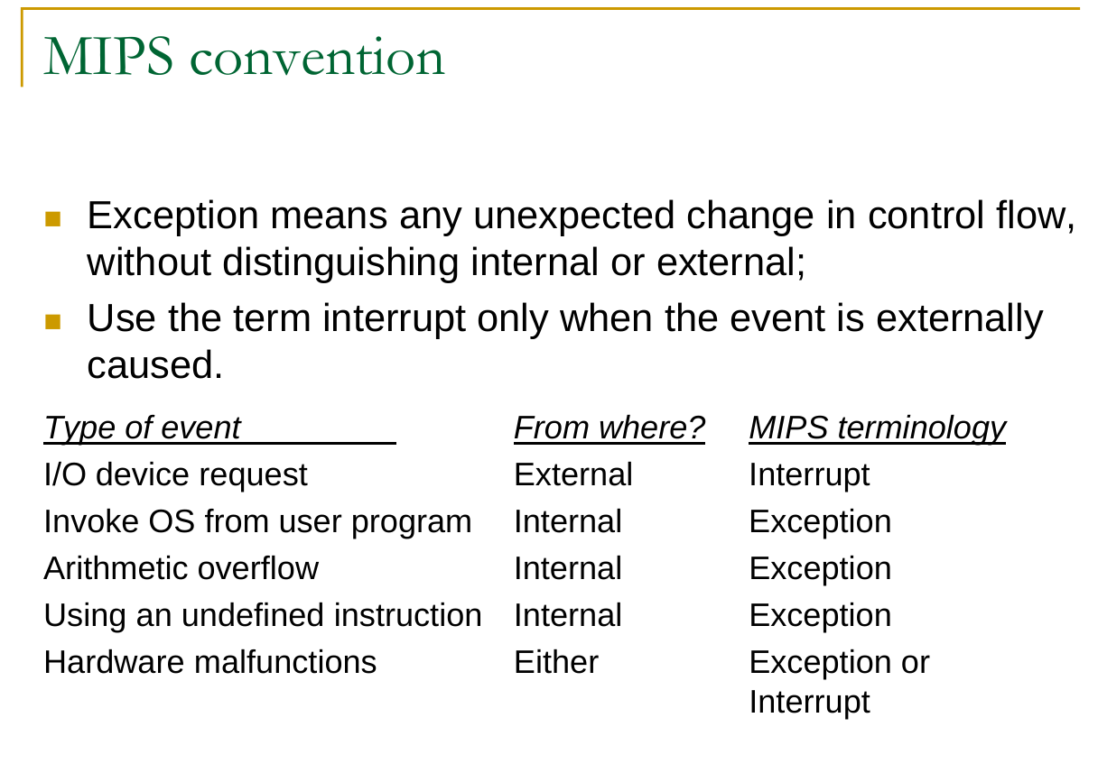

Slide 14
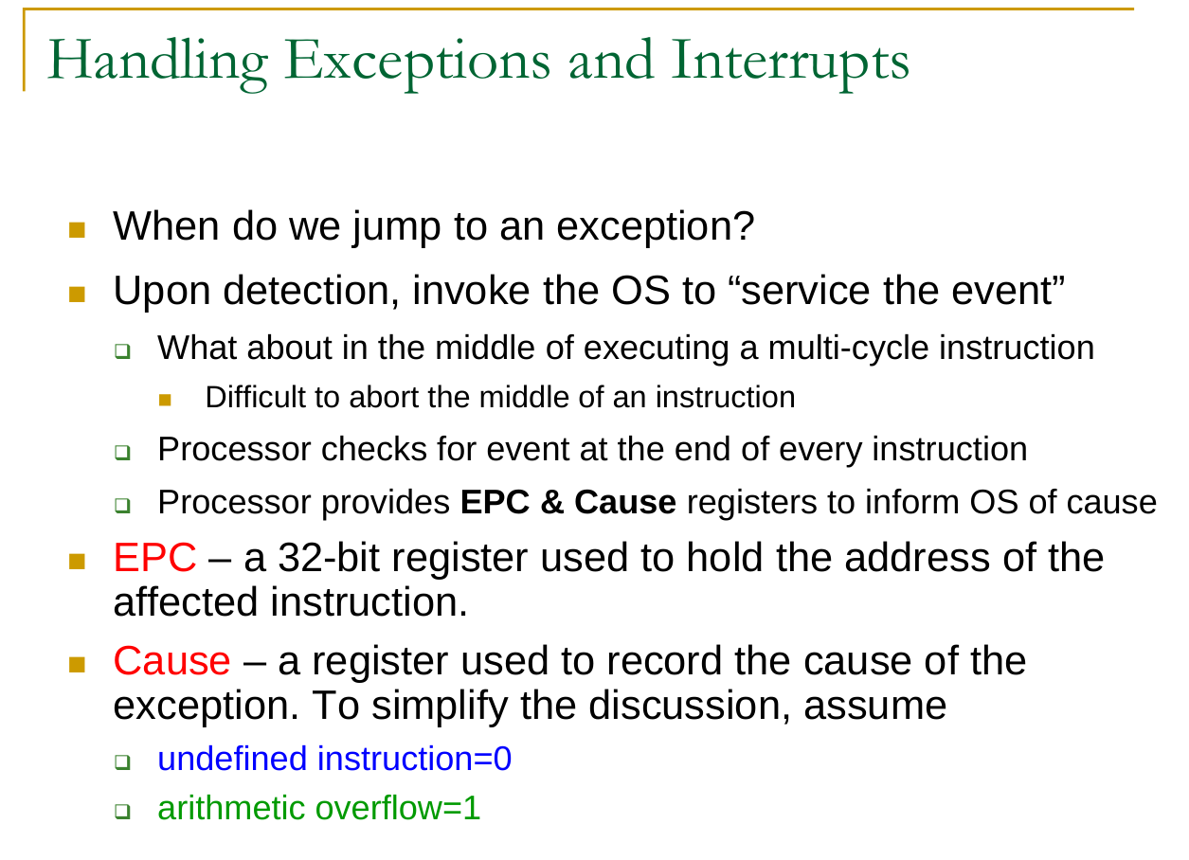

Slide 15
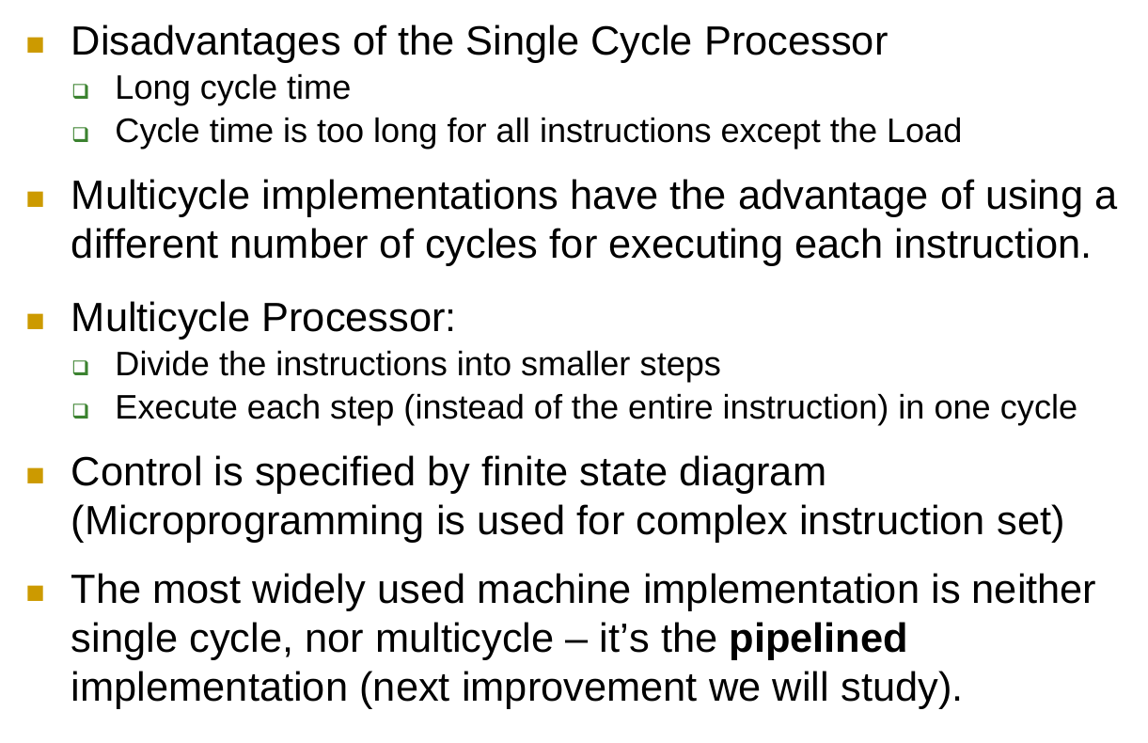
PIPELINED vs SINGLE CYCLE PROCESSOR

Slide 16
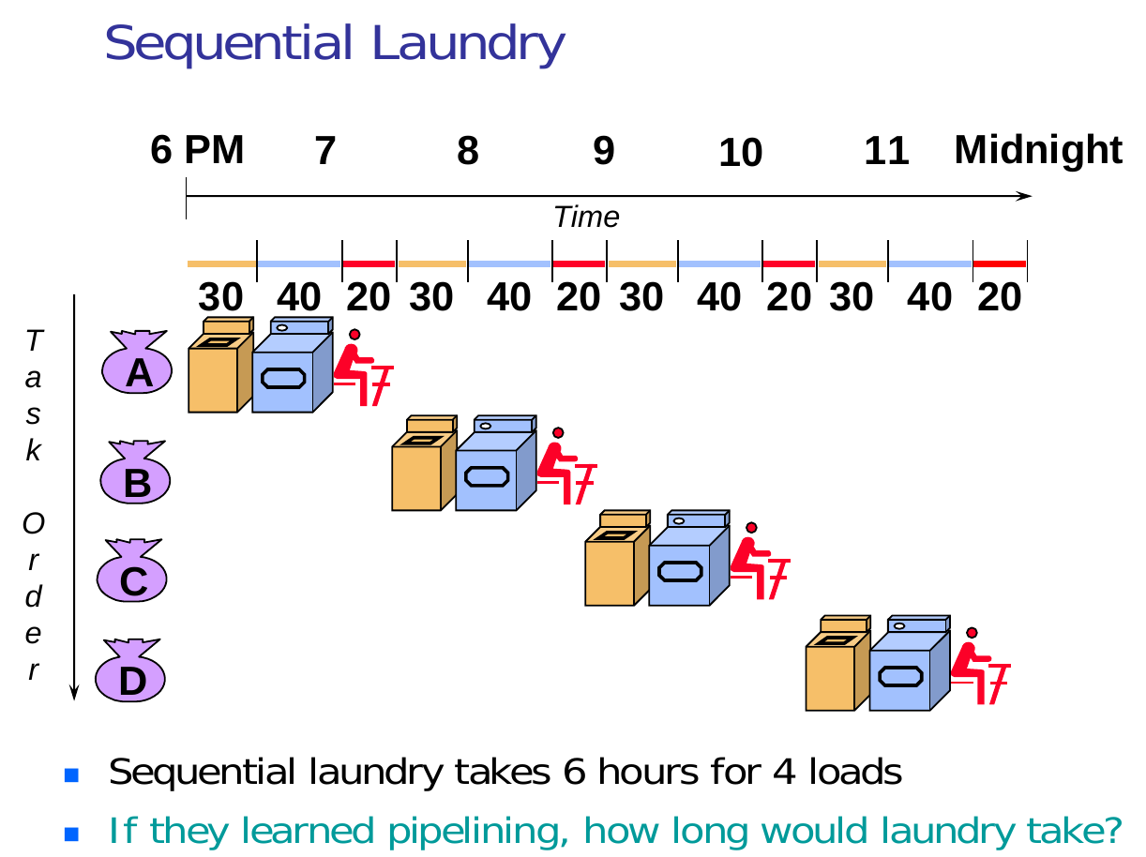

Slide 17
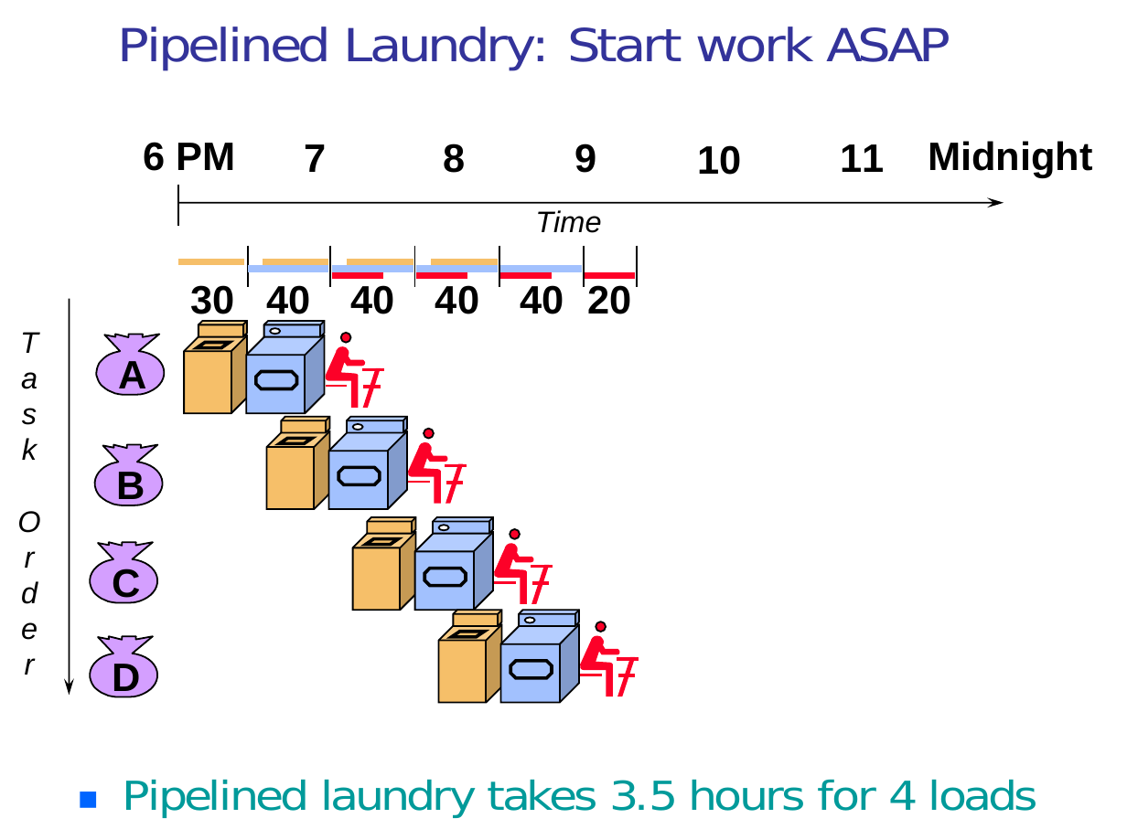

Slide 18
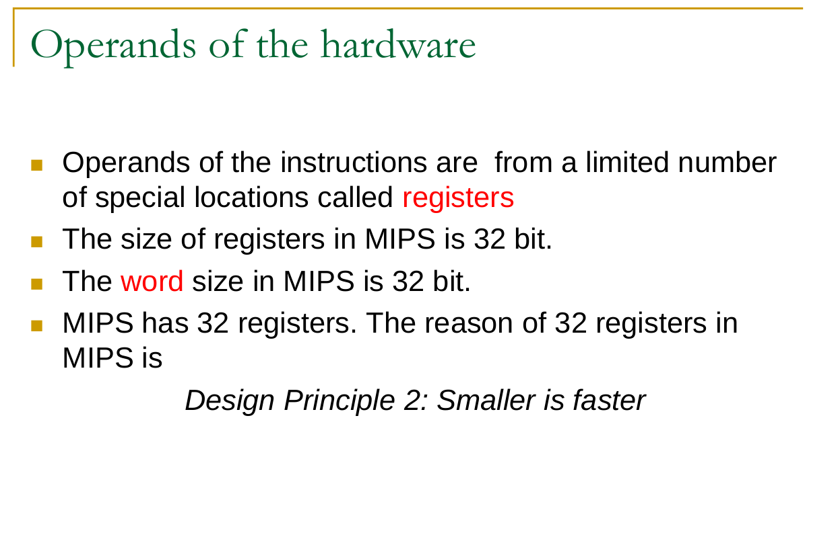

Slide 19
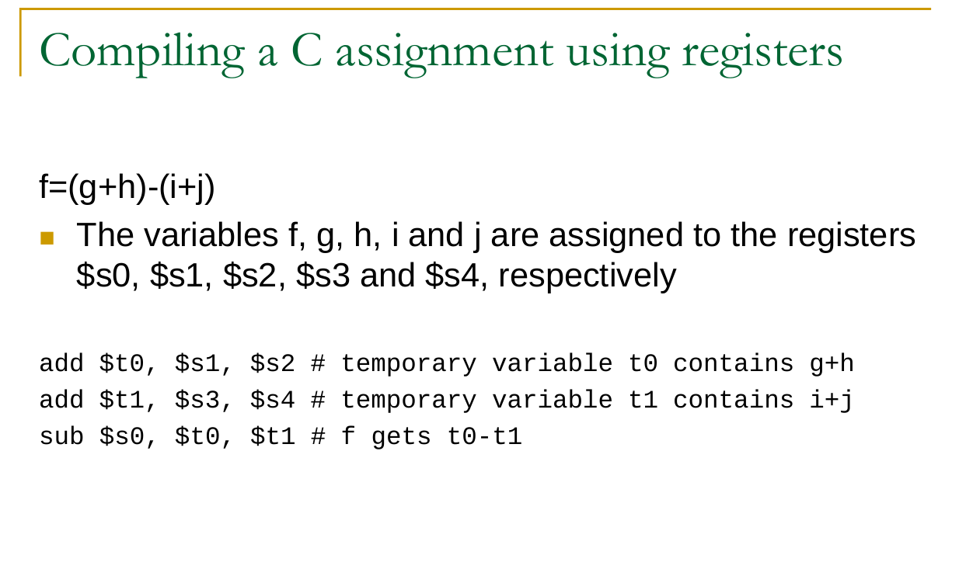

Slide 20
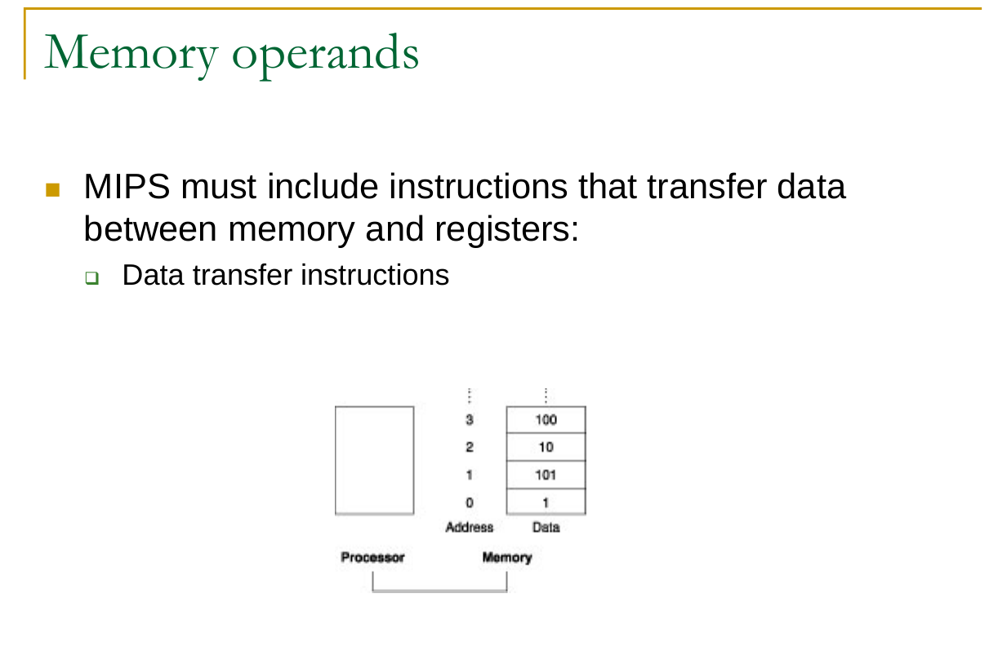

Slide 21
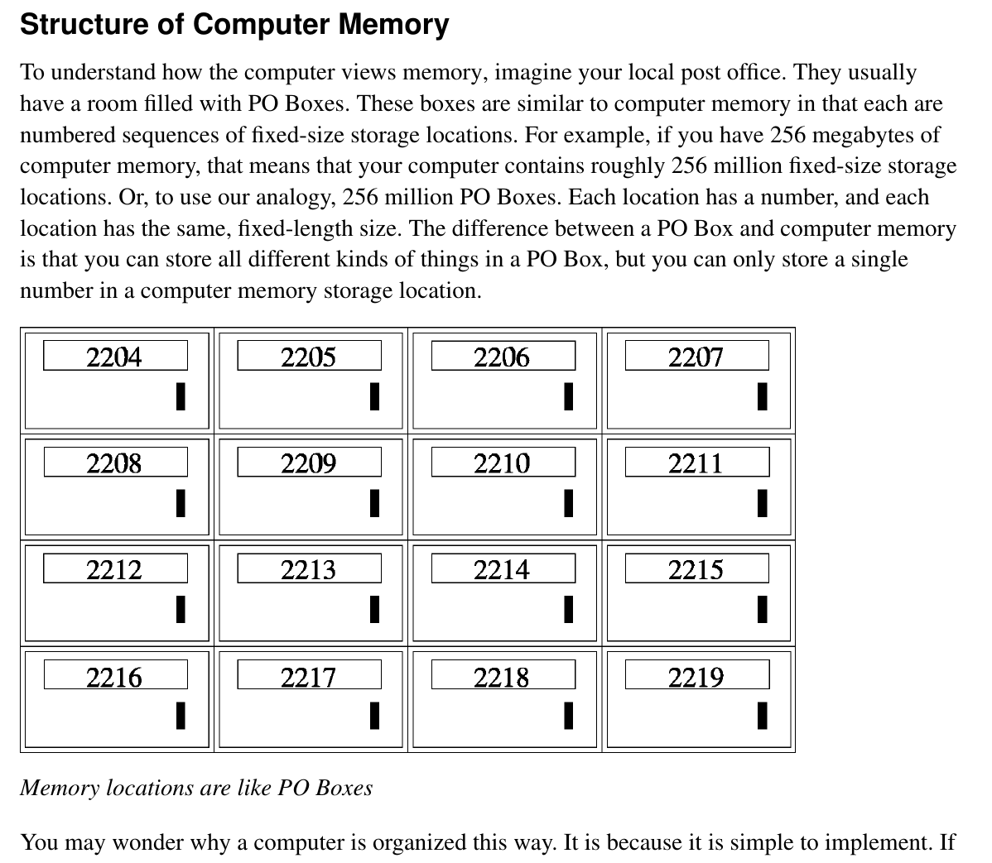

Slide 22
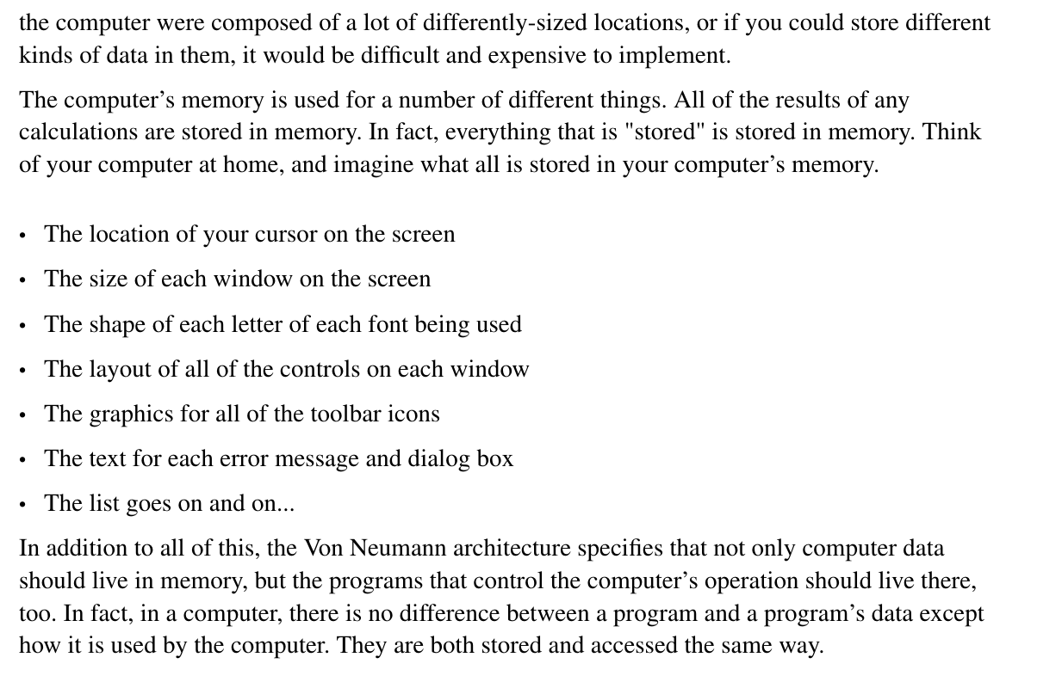
Structure Of Computer Memory cont.

Slide 23
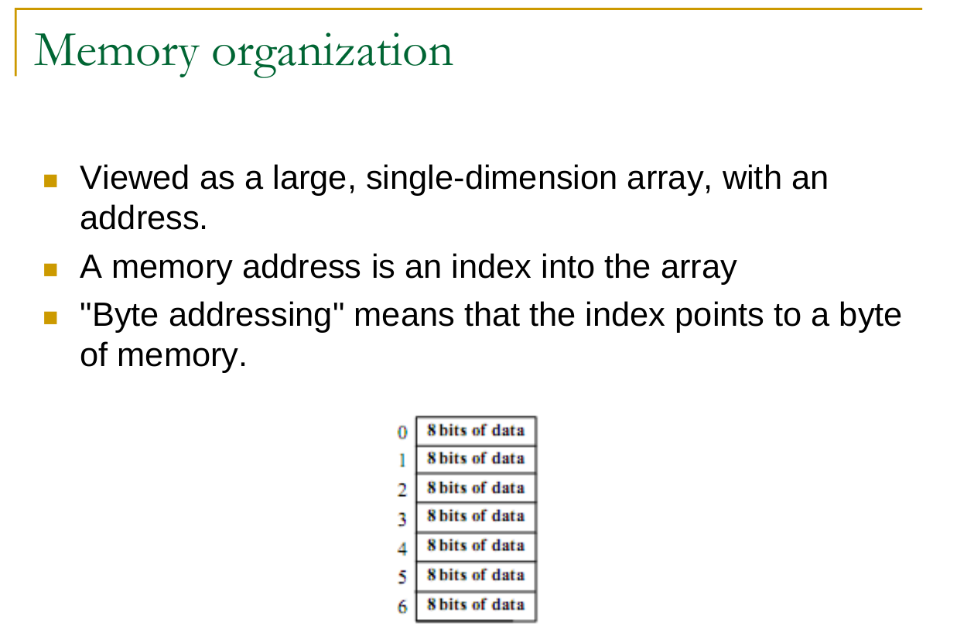

Slide 24
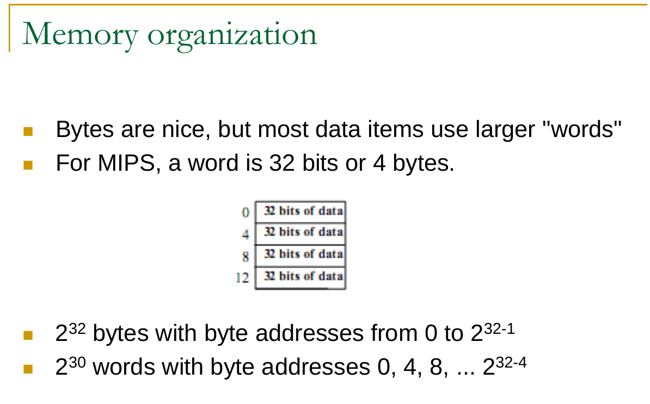

Slide 25
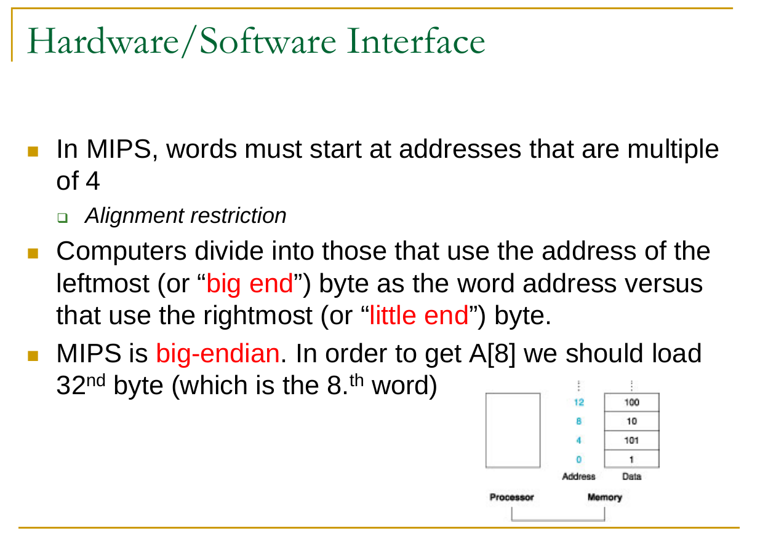

Slide 26
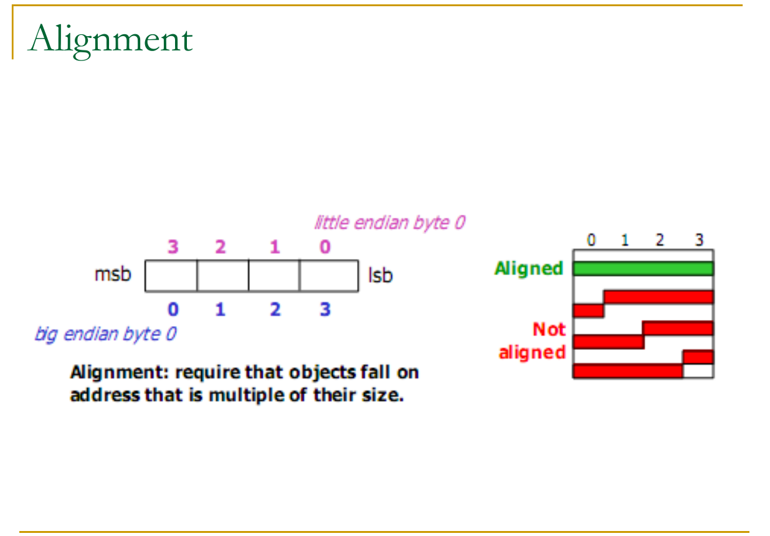

Slide 27
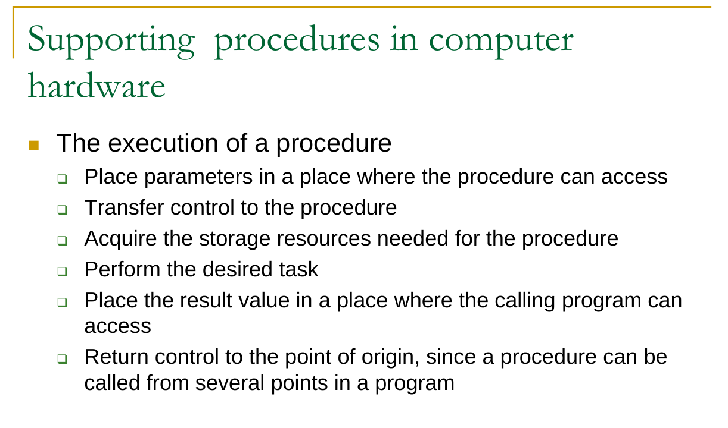

Slide 28
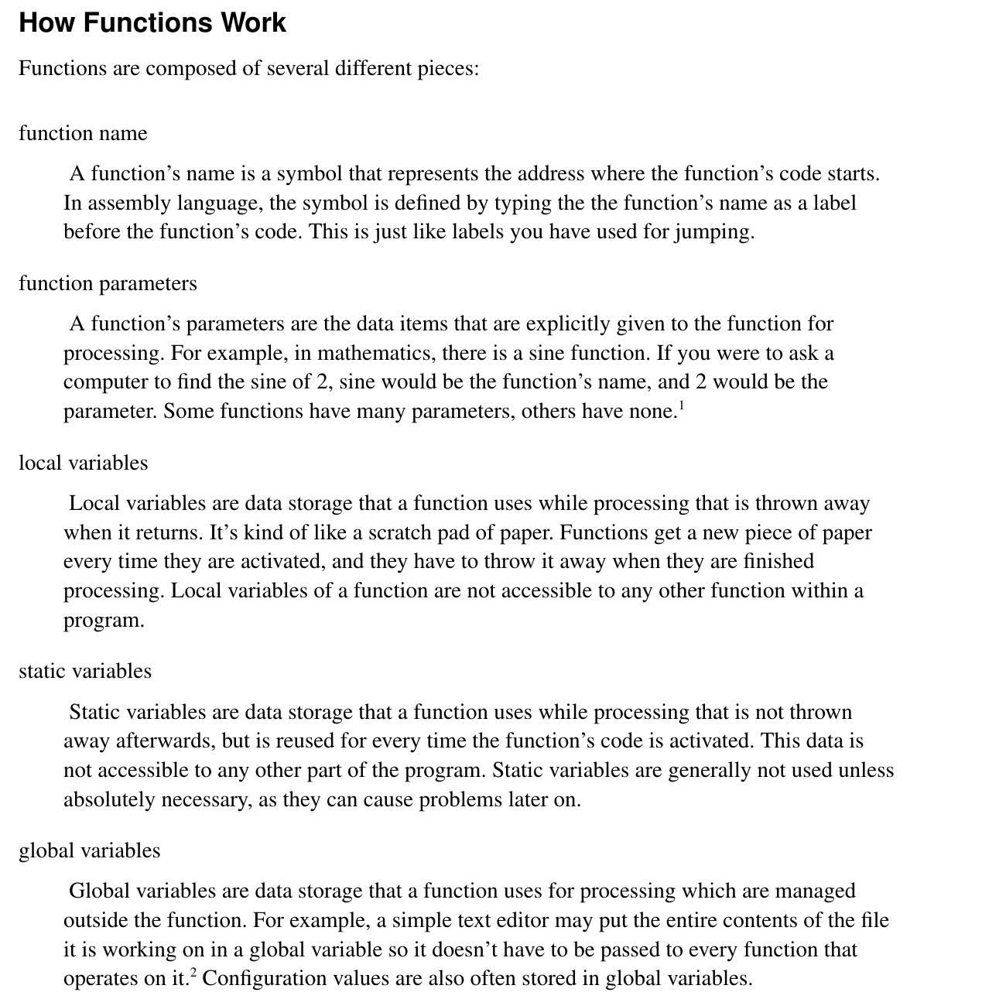

Slide 29
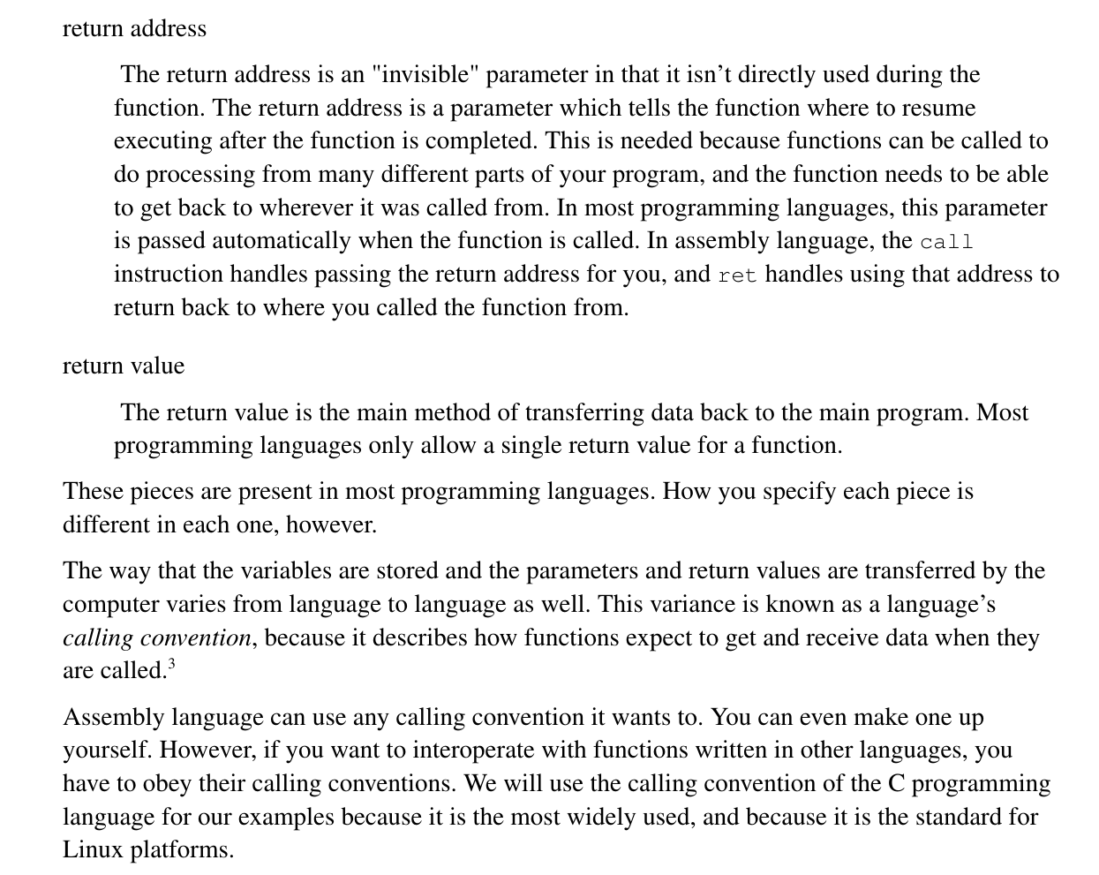
How Function Works cont.

Slide 30
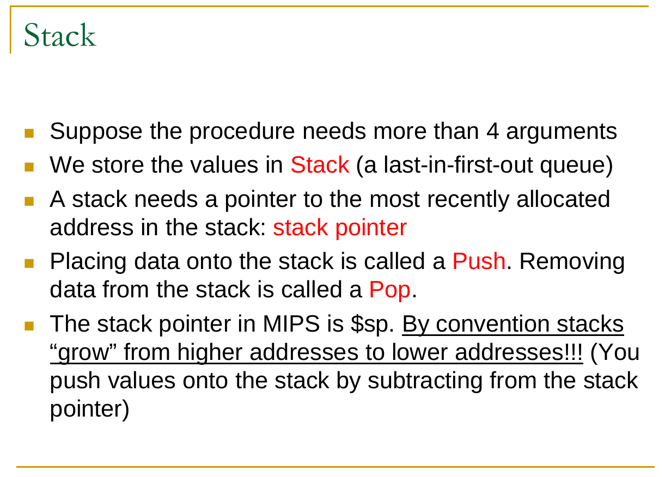

Slide 31
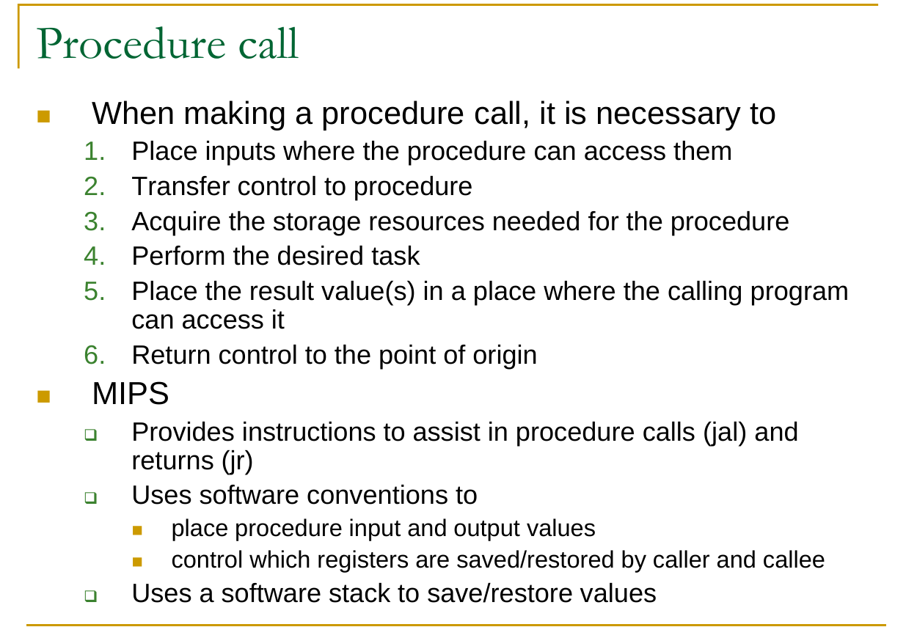

Slide 32
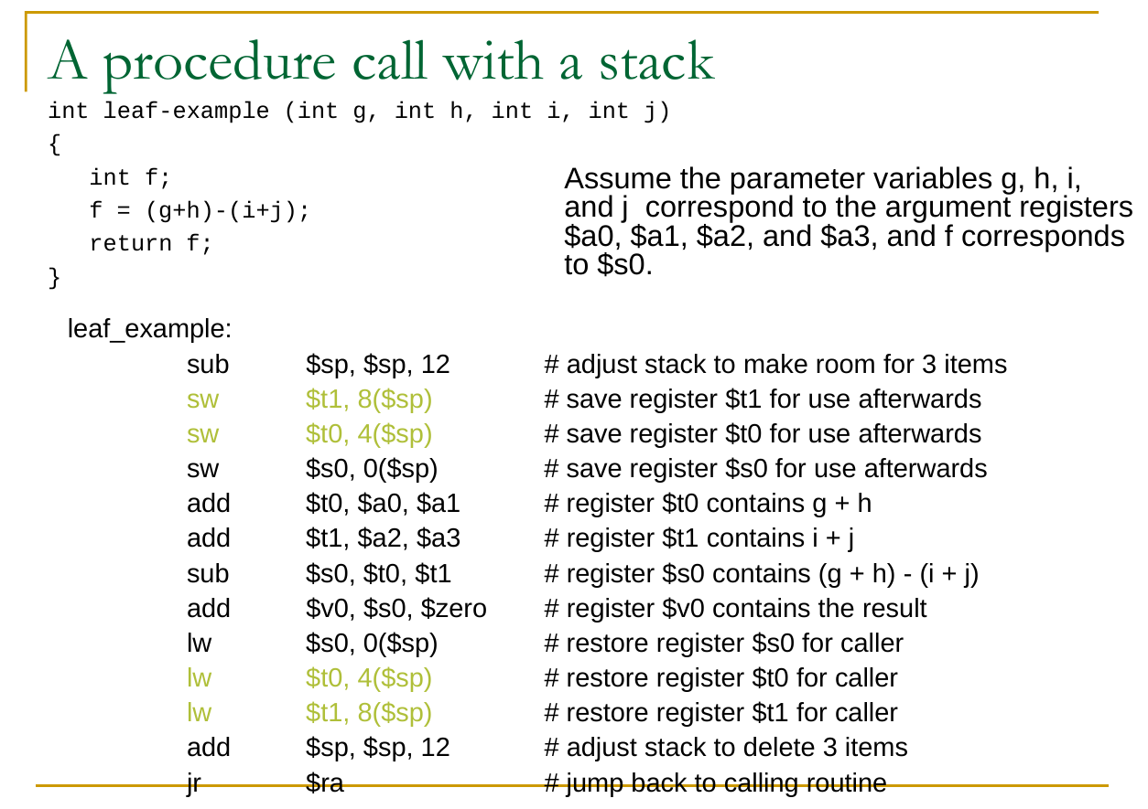

Slide 33
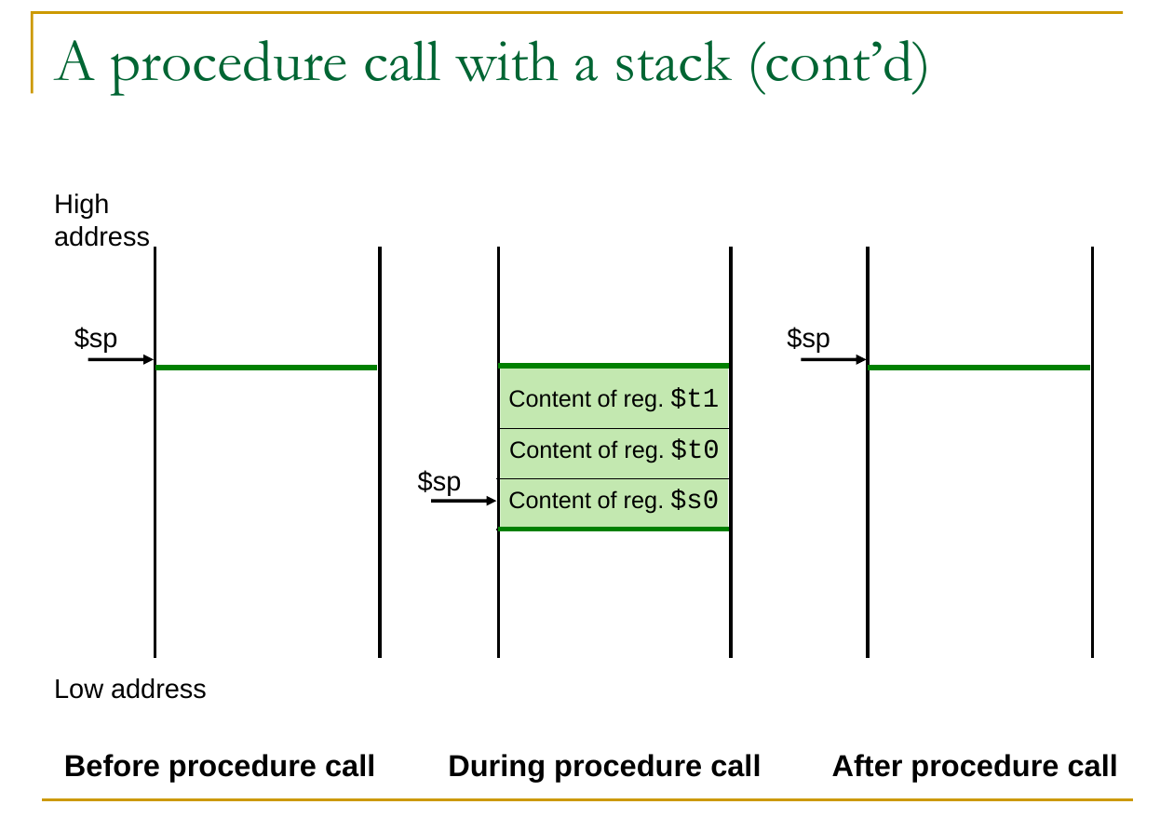

Slide 34
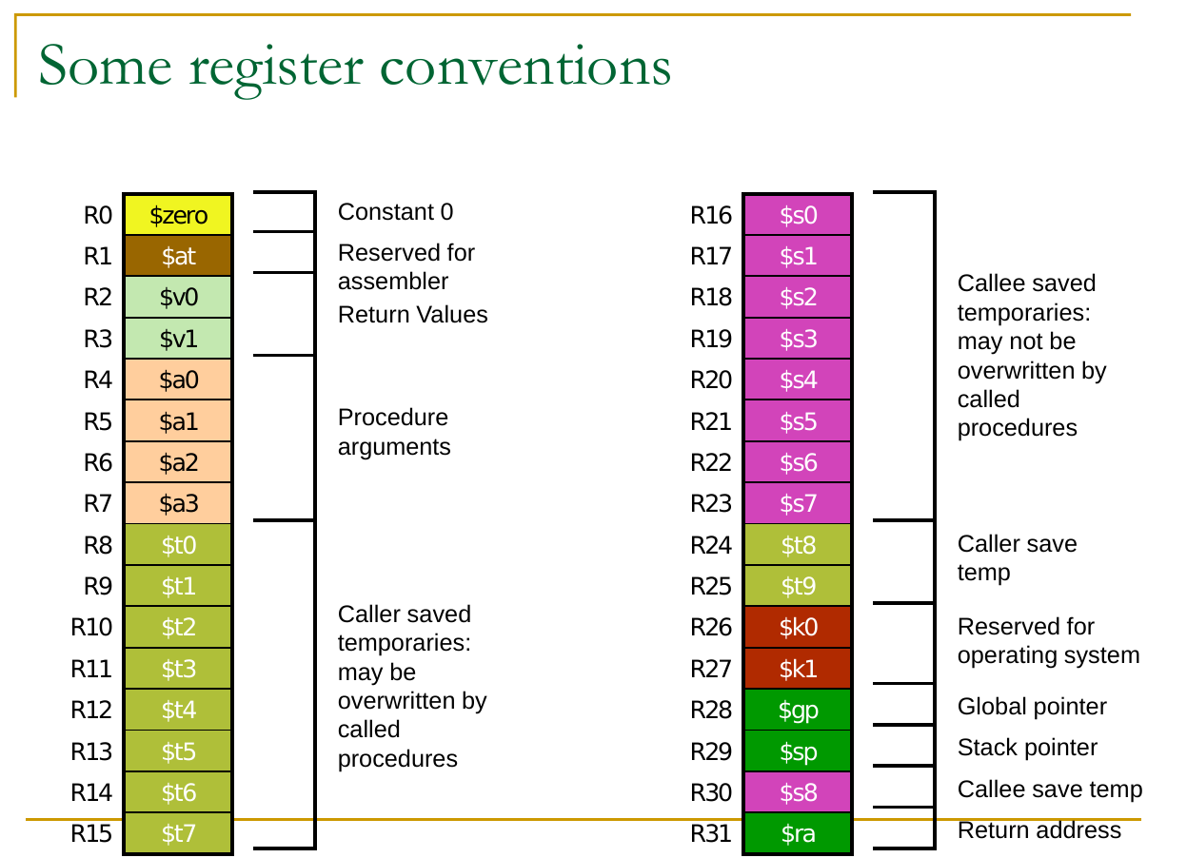

Slide 35
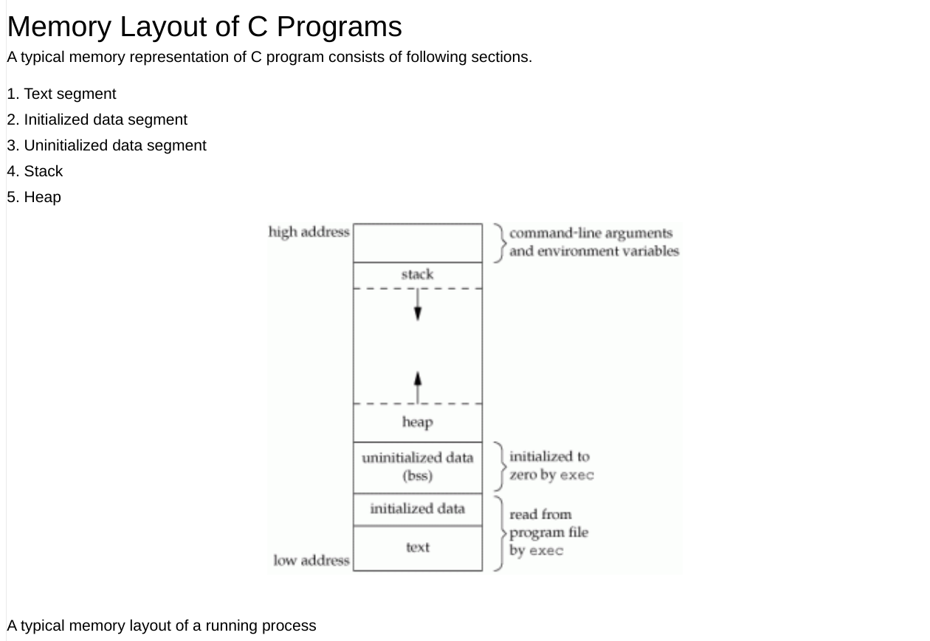

Slide 36
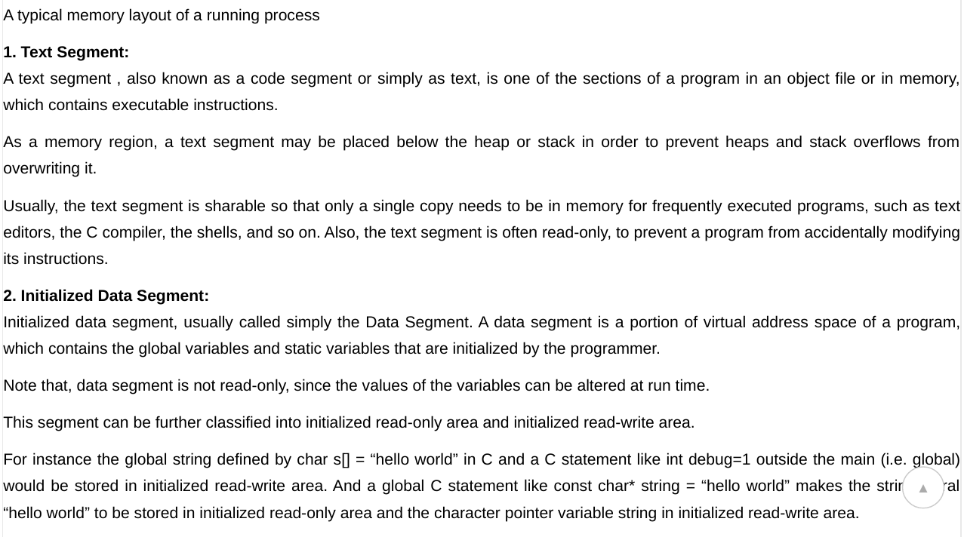
Memory Layout of C Programs

Slide 37
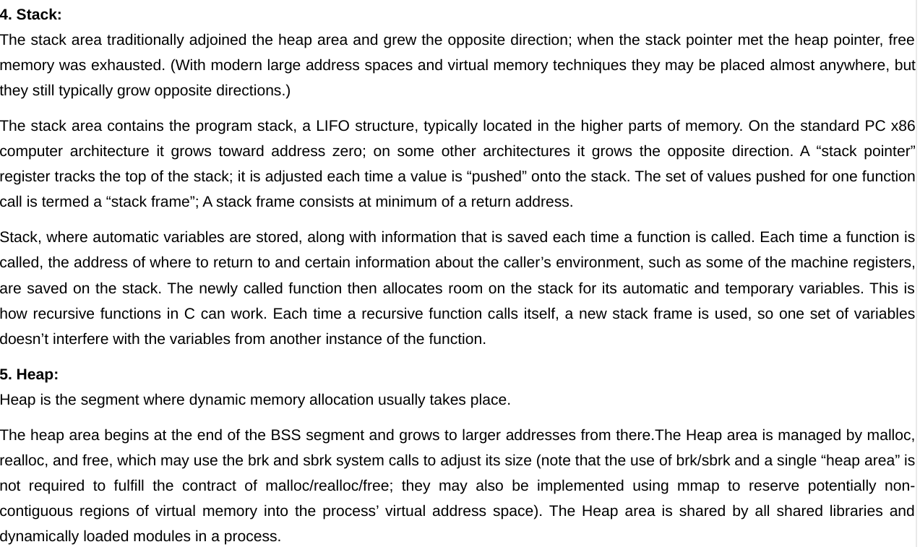

Slide 38
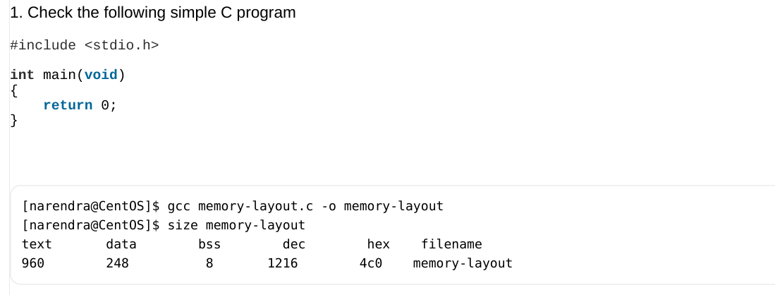
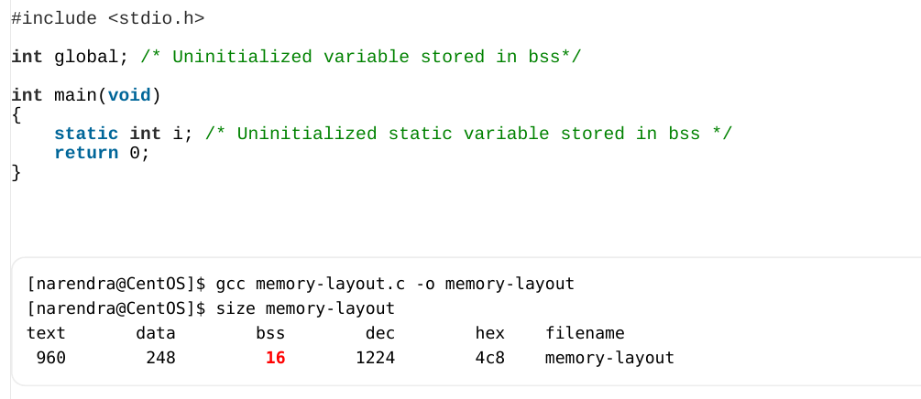

Slide 39
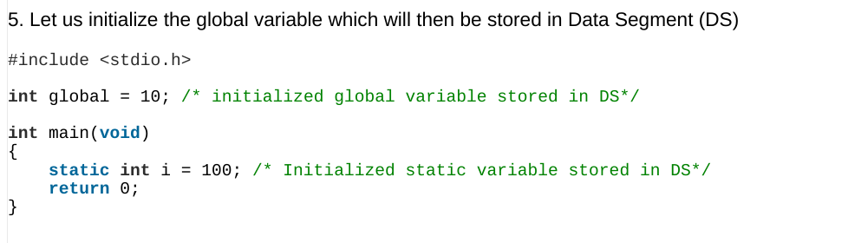
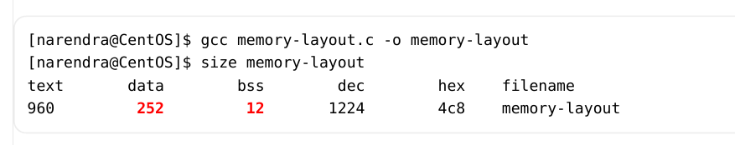

Slide 40
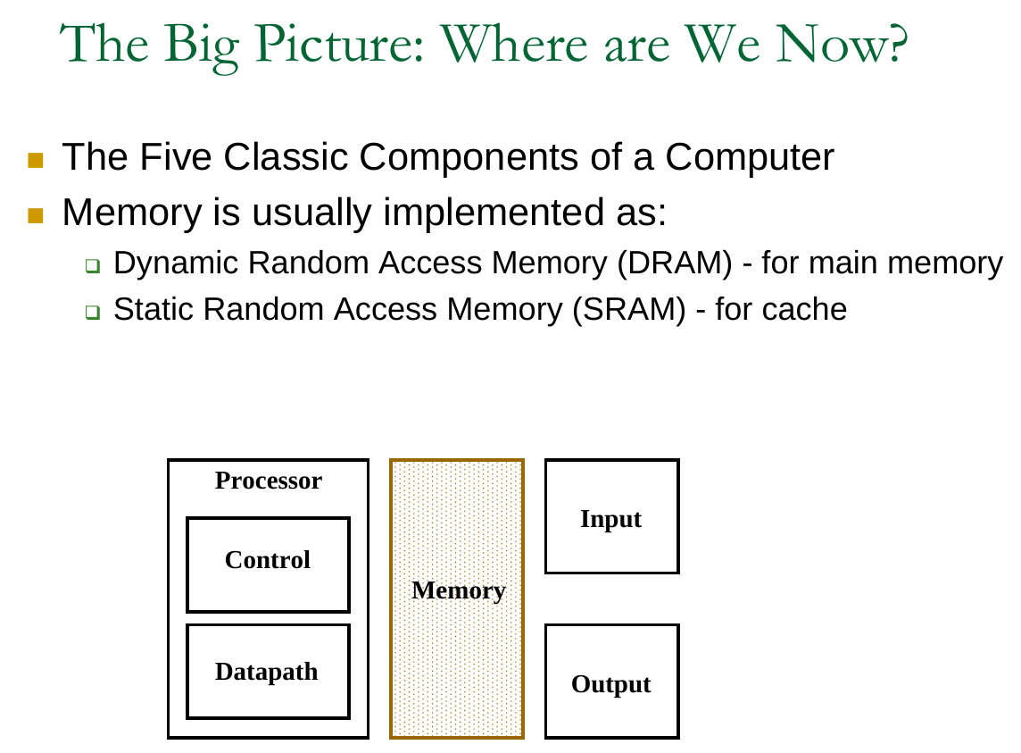

Slide 41
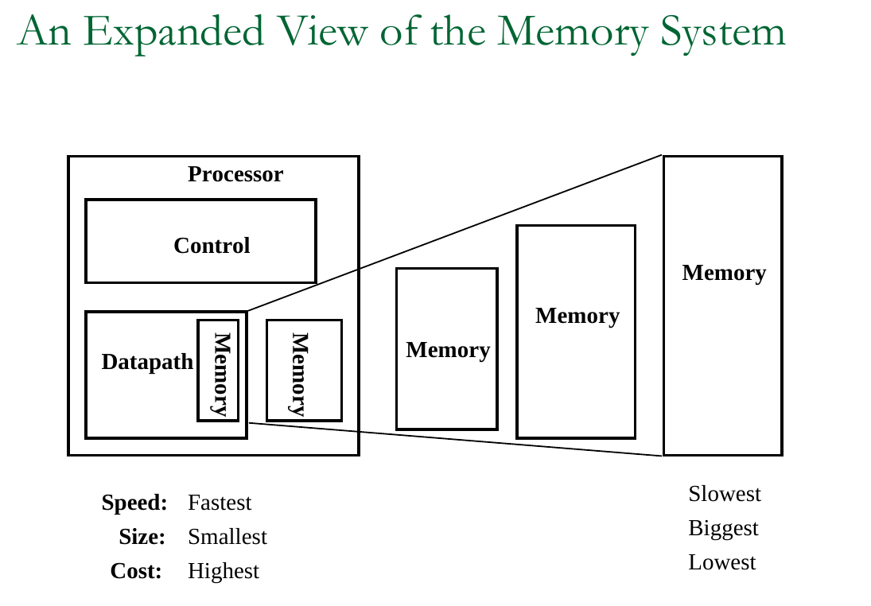

Slide 42
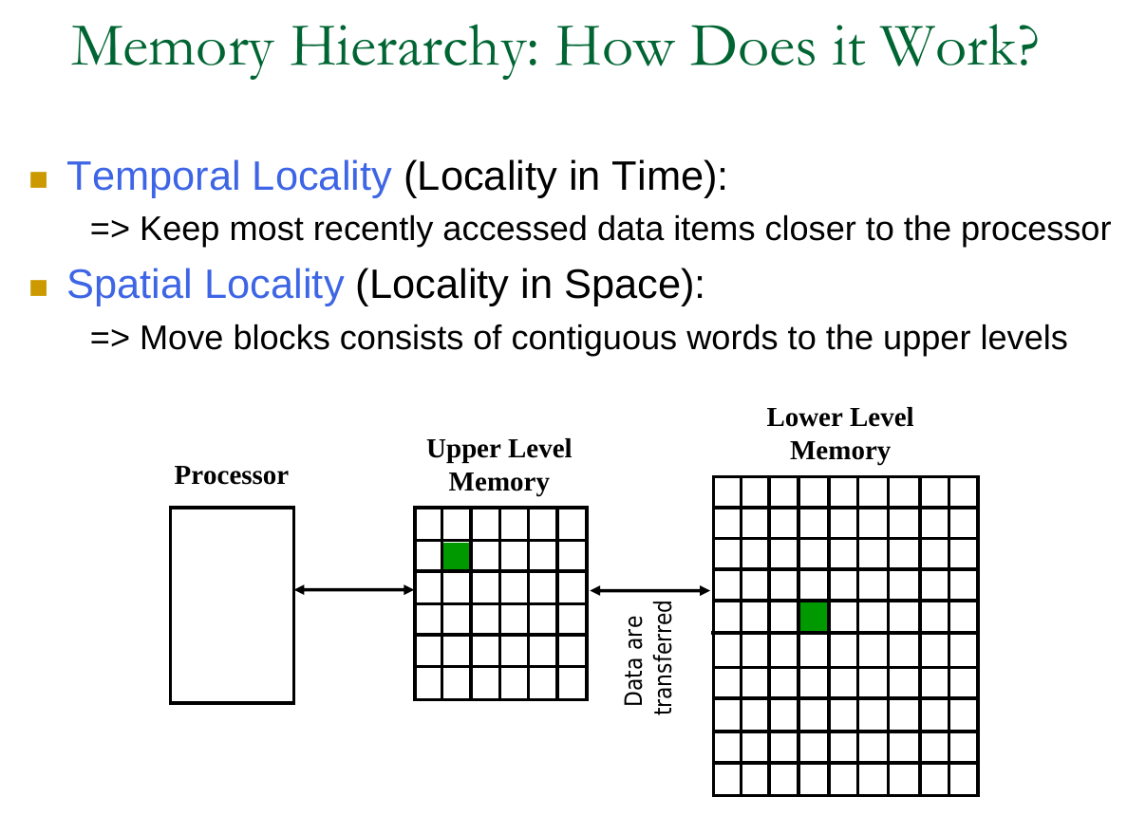

Slide 43
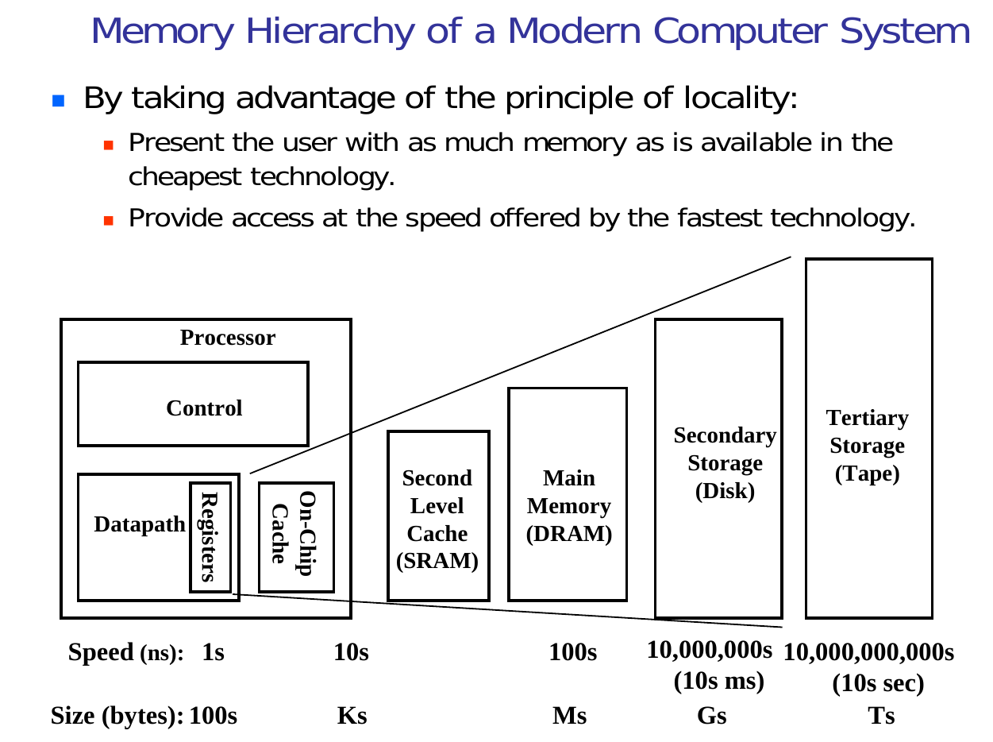

Slide 44
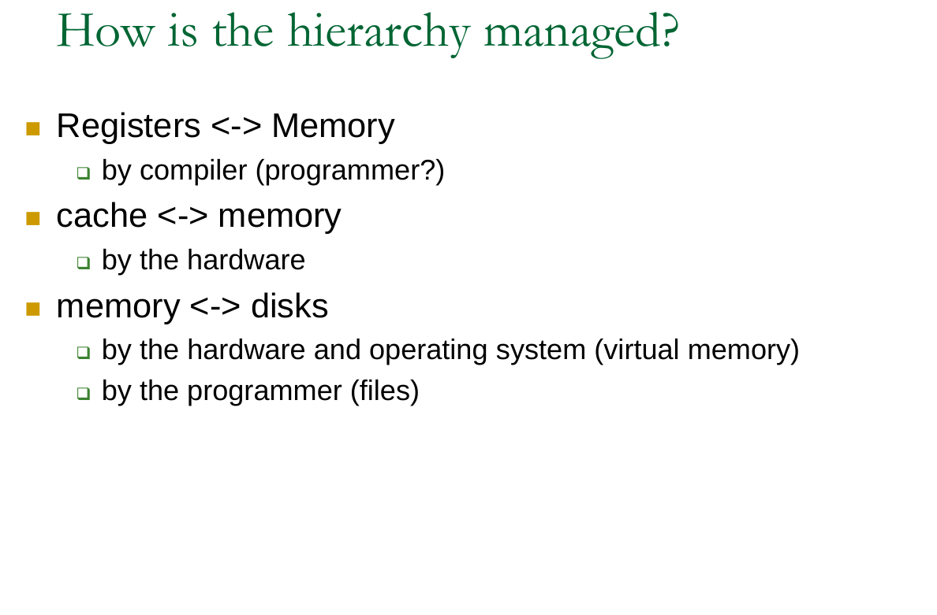

Slide 45
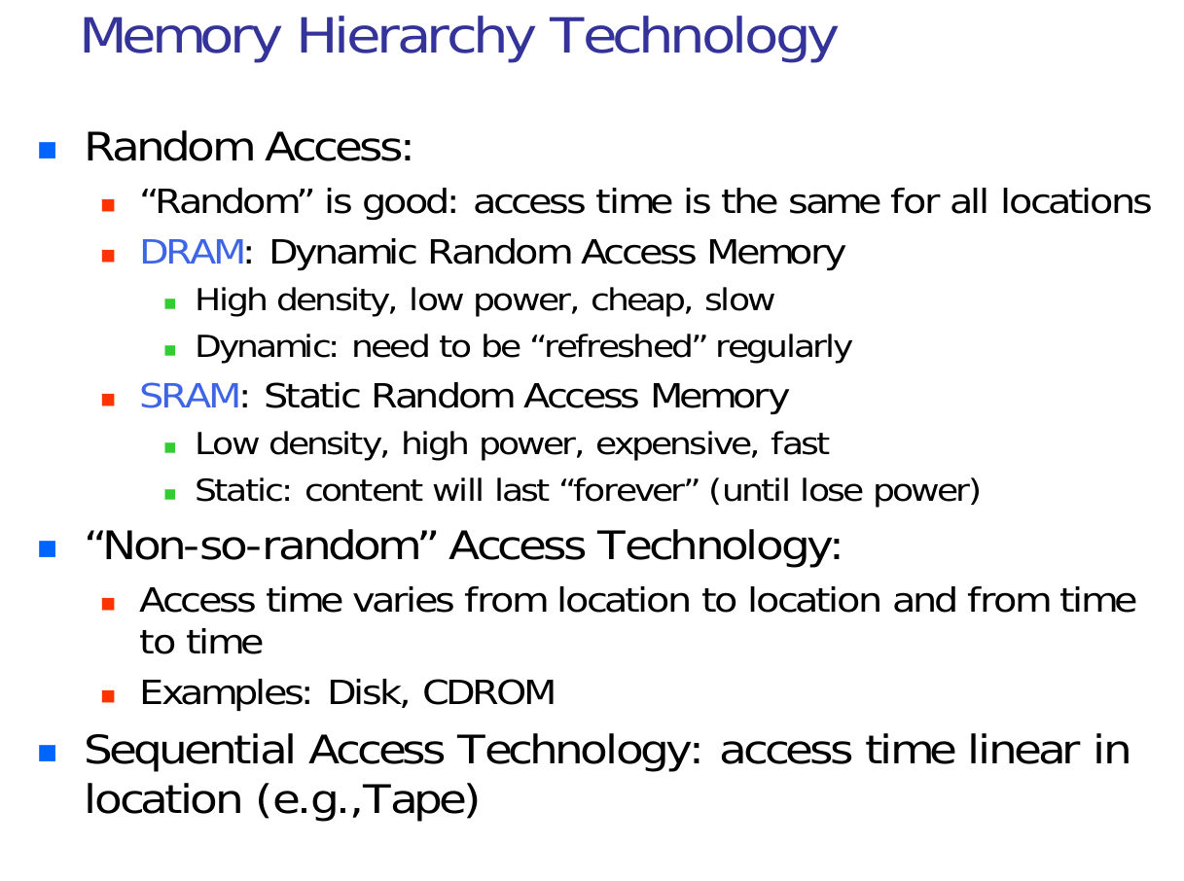

Slide 46
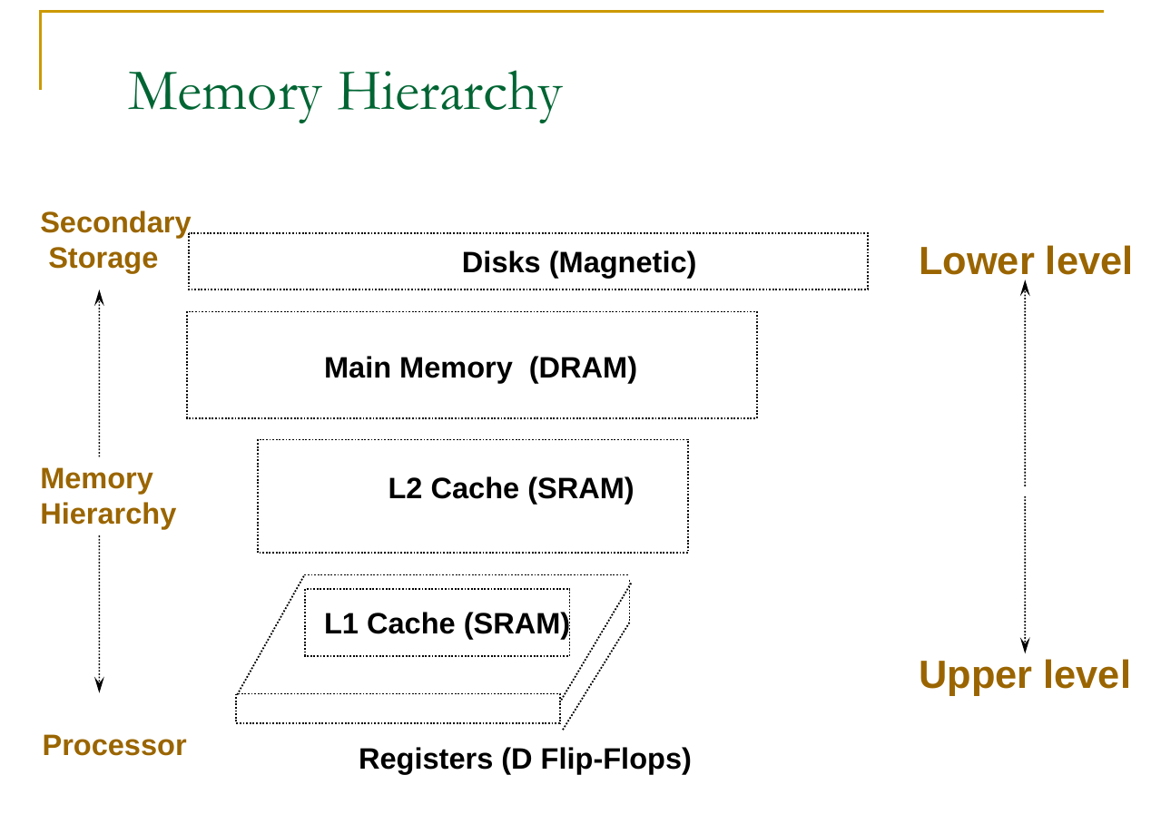

Slide 47
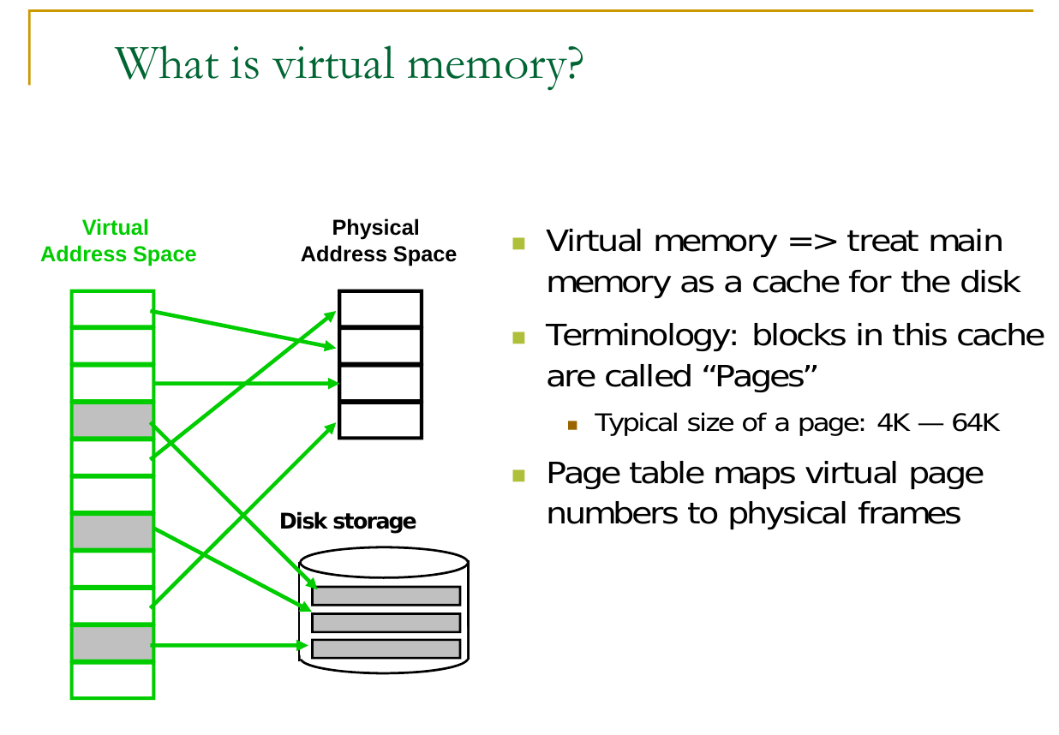

Slide 48
why virtual memory?
If you have a compiled binary, each function has a fixed address in memory and the assembly instructions to call functions have that address hardcoded. If virtual memory didn't exist, two programs couldn't be loaded into memory and run at the same time, because they'd potentially need to have different functions at the same physical address.
If two or more programs are running at the same time (or are being context-switched between) and use direct addresses, a memory error in one program (for example, reading a bad pointer) could destroy memory being used by the other process, taking down multiple programs due to a single crash.
On a similar note, there's a security issue where a process could read sensitive data in another program by guessing what physical address it would be located at and just reading it directly.
If you try to combat the two above issues by paging out all the memory for one process when switching to a second process, you incur a massive performance hit because you might have to page out all of memory.
Depending on the hardware, some memory addresses might be reserved for physical devices (for example, video RAM, external devices, etc.) If programs are compiled without knowing that those addresses are significant, they might physically break plugged-in devices by reading and writing to their memory. Worse, if that memory is read-only or write-only, the program might write bits to an address expecting them to stay there and then read back different values.

Slide 49
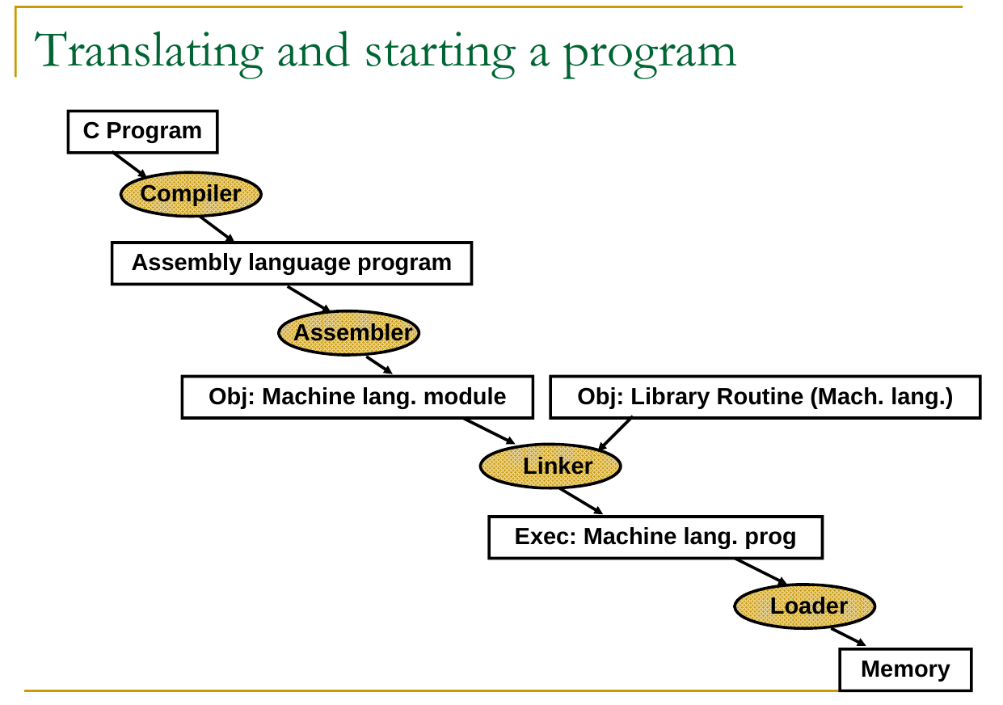

Slide 50


Slide 51


Slide 52


Slide 53


Slide 54


Slide 55


Slide 56


Slide 57


Slide 58


Slide 59
Volatile & non-volatile memory?
?

Slide 60


Slide 61


Slide 62


Slide 63


Slide 64


Slide 65


Slide 66


Slide 67


Slide 68


Slide 69


Slide 70


Slide 71


Slide 72


Slide 73

**Memory-mapped IO vs Port-mapped IO
Microprocessors normally use two methods to connect external devices: memory mapped or port mapped I/O. However, as far as the peripheral is concerned, both methods are really identical.
Memory mapped I/O is mapped into the same address space as program memory and/or user memory, and is accessed in the same way.
Port mapped I/O uses a separate, dedicated address space and is accessed via a dedicated set of microprocessor instructions.
4708 SOC System Memory Map

